Slide 1
Technical writing and presentation skills
Gender violence
Submitted To
Mam Hina

Slide 2
7 STARS
Roll no 136
134
116
101
102
146
130

Slide 3
Violence
Violence is any action, inaction, or structural arrangement that results in physical, psychological, and social harm to one or more person.
:

Slide 4
Gender violence
Gender based violence is a violation of human rights and a form of discrimination, that is directed against a person on the bases of gender.
Gender based violence both reflects and reinforce between men and between and comprises the health, dignity, security, and autonomy of its victims

Slide 5
Types of gender violence
There are six types of violence
Physical violence
Emotional or psychological violence
Financial violence
Sexual violence
Social or economic violence
Harmful traditional practices

Slide 6
Physical violence
Physical violence include hurting, or trying to hurting a partner by hitting, kicking, burning, grabbing, hair pulling, forcing alcohol or drug use. It also include property damage.
Example:
Slapping, punching,
Strangulation
Damaging personal property
Use of weapons

Slide 7
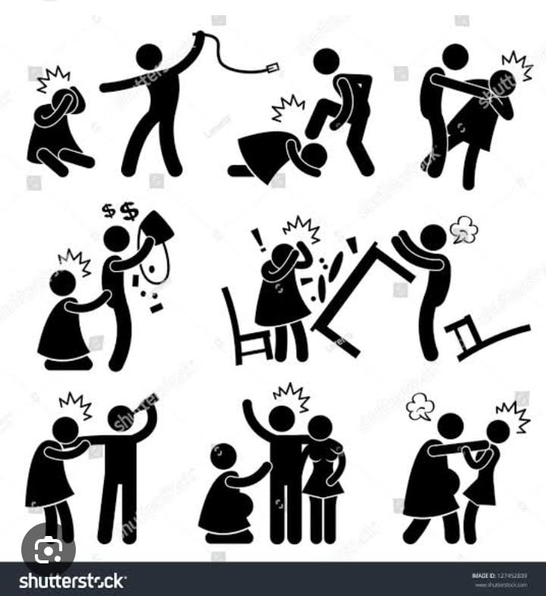
Physical violence

Slide 8
Emotional or psychological violence
Emotional abuse is when your partner tries to frighten control, or isolate you. It is not physical violence but it might involve threats of violence. It is characterized by a persons words, actions, consistency of negative behavior.
It usually starts gradually then happen aver and over
Emotional behavior can have long lasting effects on your confidence, self esteem it can cause you to develop anxiety, depression, suicidal thoughts.

Slide 9
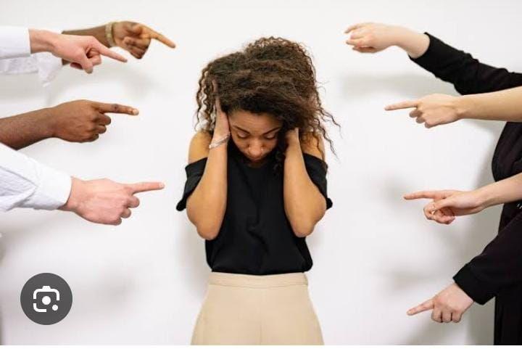
Emotional or psychological violence

Slide 10
Economic violence
Economic violence includes making a person financially dependent by maintaining control over financial resources or forbidding attendance at school or employment
Example
Inflicting physical harm or injury that would prevent the person from attending work
Harassing partner at their work place
Damaging a partner credit score

Slide 11
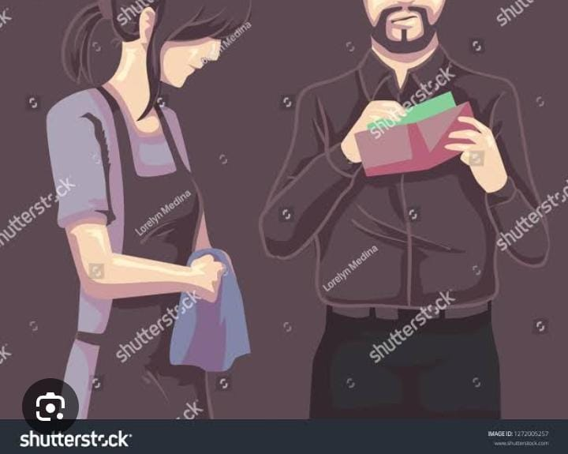
Economic violence

Slide 12
Sexual violence
Sexual violence means that some one forces or manipulates some one else into unwanted sexual activity without their consent
Forms of sexual violence
Touching the child private part
Exposing an adult private parts to the child
Who are abusers?
Stepparents
Strangers
Consequence of sexual abuse
Anxiety
Depression
Sleep disorder
Gain and loss weight

Slide 13
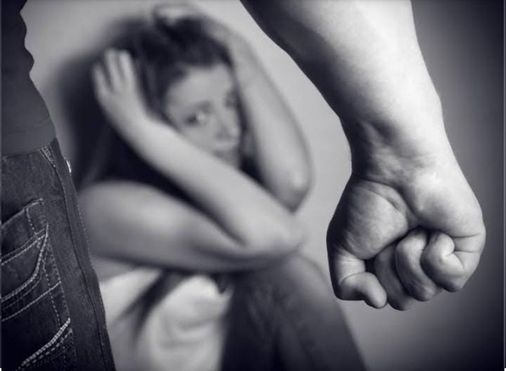
Sexual violence

Slide 14
Harmful traditional practices
Acts specific to culture in which girls and women are severely undervalued and considered second class citizens with fever right
These include honor killing, early marriages
Example
Female genital cutting
Forced marriage
Early marriage
Denial of education and economic opportunities for women's and girls

Slide 15
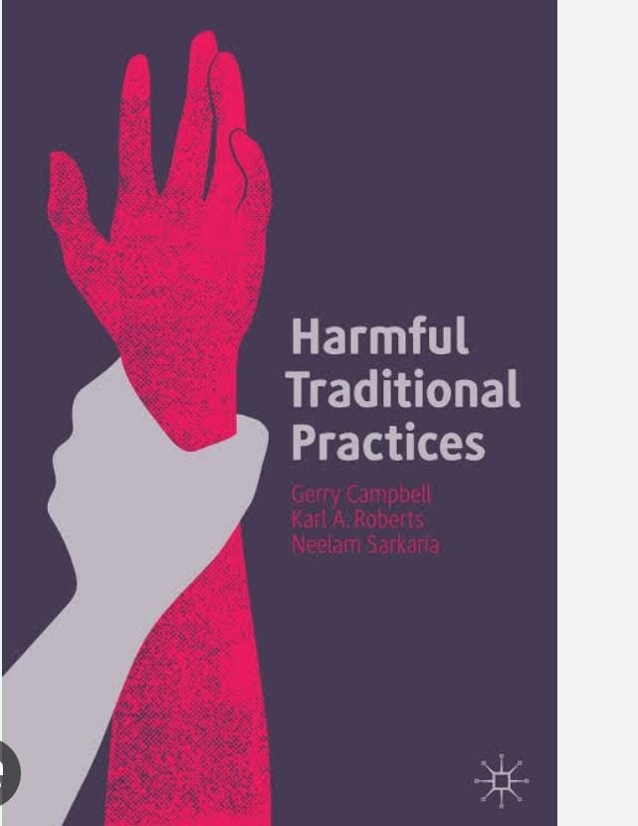
Harmful traditional practices

Slide 16
Social violence
Maintaining total control or financial resources, withholding access to money and forbidding attendance at school or employment.
Usually done by an intimate partner, or by laws, and policies to opportunities.

